Slide 1

Big Data
Introduction to Hadoop, Spark, and Their Applications in Data Science

Slide 2
What is Big Data?
Definition: “Big Data refers to large, complex datasets that are difficult to process and analyse using traditional methods.”
Key Characteristics (5 Vs):
Volume: Massive amounts of data
Velocity: High speed of data generation
Variety: Diverse data types (structured, unstructured, semi-structured)
Veracity: Uncertainty in data accuracy
Value: Insights derived from data

Slide 3
Big Data 5vs :
BIG DATA
Volume
Massive amount of Data
Velocity
High speed of data generation
Veracity
Authenticity
Origin, Reputation
Availability
Variety
Diverse data types
Value
Statistical
Events
Correlation

Slide 4

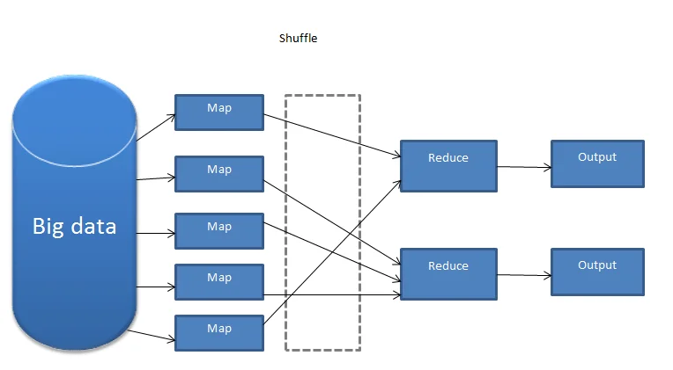
Introduction to Hadoop
Definition: Open-source framework for distributed storage and processing of big data.
Core Components:
HDFS (Hadoop Distributed File System): For storage.
MapReduce: For processing data.
YARN: Resource management.
Applications:
Data storage for large enterprises
Log analysis and processing
Batch processing of big datasets

Slide 5
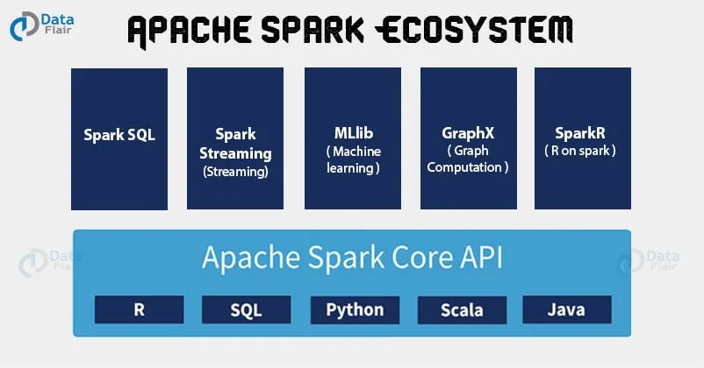
Introduction to Spark
Definition: Open-source, distributed computing system optimized for big data analytics.
Key Features:
In-memory computation for faster processing
Supports batch and real-time data processing
Rich library ecosystem (MLlib for machine learning, GraphX for graph processing)
Applications:
Streaming analytics
Machine learning model training
Interactive data analysis

Slide 6
Hadoop vs. Spark
Feature | Hadoop | Spark
Processing | Batch processing | Batch & real-time
Speed | Slower (disk-based) | Faster (in-memory)
Ease of Use | Complex (MapReduce coding) | Easier (higher-level APIs)
Libraries | Limited | Rich ecosystem

Slide 7


Applications in Data Science
Hadoop Applications:
Storing and processing petabytes of data
ETL (Extract, Transform, Load) workflows
Analyzing large-scale logs
Spark Applications:
Real-time fraud detection
Training machine learning models at scale
Analyzing streaming data from IoT devices

Slide 8
Real-World Use Cases
Hadoop:
Facebook: Stores user activity logs
LinkedIn: Processes large datasets for recommendations
Spark:
Netflix: Real-time recommendation engine
Uber: Real-time ride pricing and matching

Slide 9
Challenges and Future of Big Data
Challenges:
Data security and privacy
Integration with existing systems
High infrastructure costs
Future Trends:
Cloud-native big data solutions
AI and machine learning integration
Real-time analytics advancements

Slide 10

Conclusion
Key Takeaways:
Big data technologies like Hadoop and Spark are essential for processing massive datasets.
These tools enable advanced analytics, real-time processing, and scalable solutions.
As data continues to grow, these technologies will evolve to meet future challenges.

Slide 11
References
Apache Hadoop: https://hadoop.apache.org/
Apache Spark: https://spark.apache.org/

